Slide 1
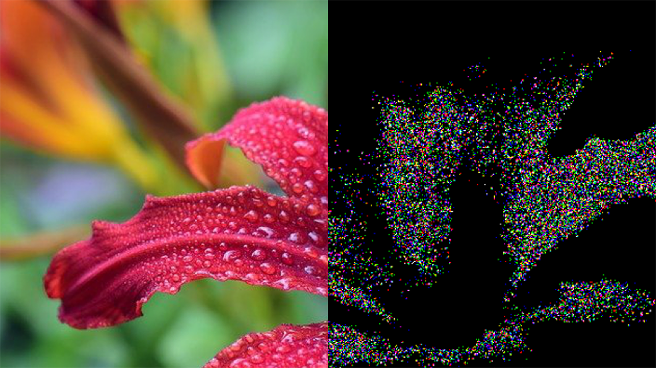
STEGNOGRAPHY PROJECT - DARSHANA PATIL

Slide 2
CONTENT
Introduction
Example
Advantage
Disadvantage
Techniques
Image Steganography
Proposed Model
References

Slide 3
INTRODUCTION
Steganography is the technique of hiding secret data within an ordinary, non-secret, file message in order to avoid detection; the secret data is then extracted at its destination.
The use of or steganography can be combined with encryption as an extra step for hiding or protecting data.
The word steganography is derived from the Greek words steganos (meaning hidden or covered) and the Greek root graph (meaning to write)

Slide 4
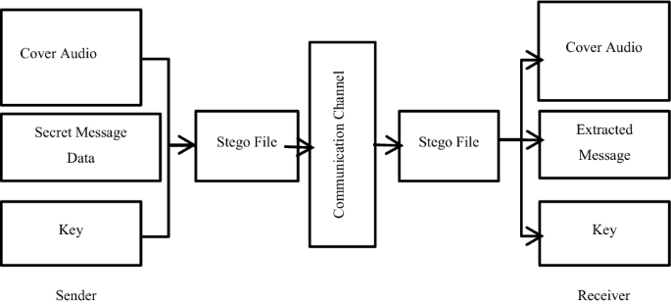
STEGNOGRAPHY

Slide 5
STEGNOGRAPHY
HIDING IN TEXT
HIDING IN VIDEO
HIDING IN IMAGE
HIDING IN SOUND FILE

Slide 6
ADVANTAGES
Difficult to Detect
Only Receiver can Detect
It can done faster through large no. of softwares
Important communication exchange
Provides better security through LAN, MAN, WAN
Can be applied differently with audio, video and Image.
Hide data over encryption is that it helps obscure the fact that there is sensitive data hidden in the file or other content carrying the hidden text.

Slide 7
DISADVANTAGES
Only Small size of photos can conceal
Breaking down of software or server can replicate the Data
Suspicious Activity Inclusion
Invalidate Signatures
Invalidate Hashing

Slide 8
STEGANOGRAPHY TECHNIQUES
Text Steganography
Image Steganography
Video Steganography
Audio Steganography
Network Steganography

Slide 9
IMAGE STEGANOGRAPHY
Hiding the data by taking the cover object as the image is known as image steganography. In digital steganography, images are widely used cover source because there are a huge number of bits present in the digital representation of an image. There are a lot of ways to hide information inside an image.
Least Significant Bit Insertion
Masking and Filtering
Redundant Pattern Encoding

Slide 10
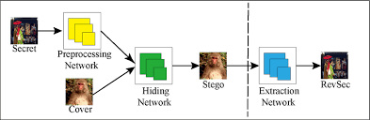
IMAGE STEGNOGRAPHY
Hiding the data by taking the cover object as the image is known as image steganography. In digital steganography, images are widely used cover source because there are a huge number of bits present in the digital representation of an image. There are a lot of ways to hide information inside an image.
Least Significant Bit Insertion
Masking and Filtering
Redundant Pattern Encoding

Slide 11
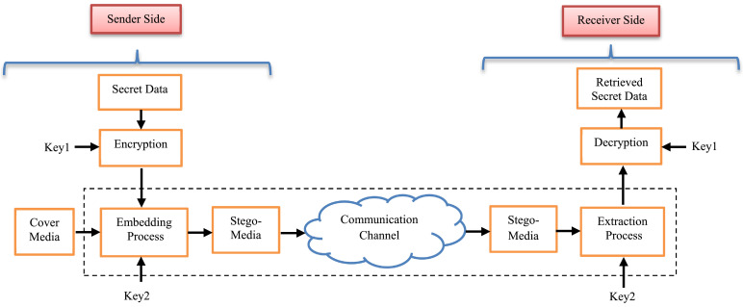
PROPOSED MODEL

Slide 12
CONCLUSION
This Software will be Harder and more complex
Any Shape and Size Image will Hide and Carry Message
Less Data Reduction
Image Communication with less time and space complexity
Active and passive attacks will not easily able to break down the system

Slide 13
REFERENCES
https://en.wikipedia.or g/wiki/Steganography
https://www .ukessays.com/essays/computer-science/the-types-and-techniques-of-steg anography-computer-science-essay.php
https://www .ques10.com/p/33259/explain-steganography-and-its-types/
https://searchsecurity .techtarget.com/definition/steganography#:~:text=Steganograph y%20is%20the%20technique%20of,for%20hiding%20or%20protecting%20data.
https://www .spiedigitallibrary.org/conference-proceedings-of-spie/6074/60740G/Wir eless-steganography/10.1117/12.650263.short?SSO=1

